Slide 1

Mobile Programming Term Project
17102062
Lee Yong Hoon

Slide 2
Table
Background
Methodology
UI/UX (drawable)
UI/UX (layout)
code
Demonstration

Slide 3
Background

Slide 4
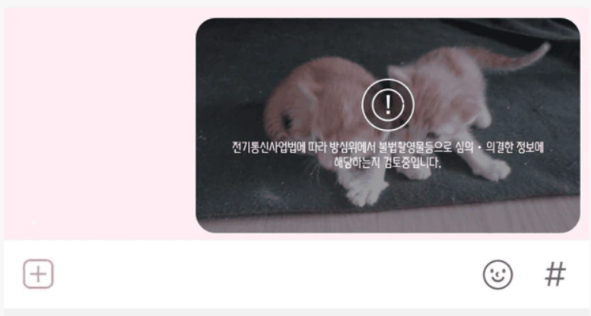
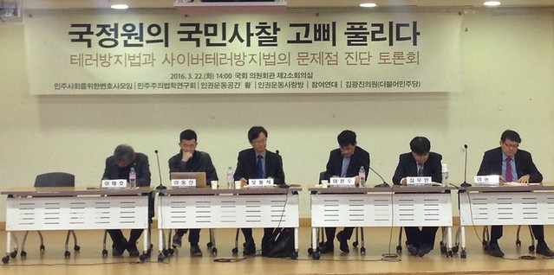
Background
The Nth Room Prevention Act and the Anti-Terrorism Act have good intentions, but the possibility of a public inspection is being raised.
Therefore, we try to develop an application that can avoid this problem through the development of our own chat application.
Also, I want to talk to my friends through our own chat room.

Slide 5
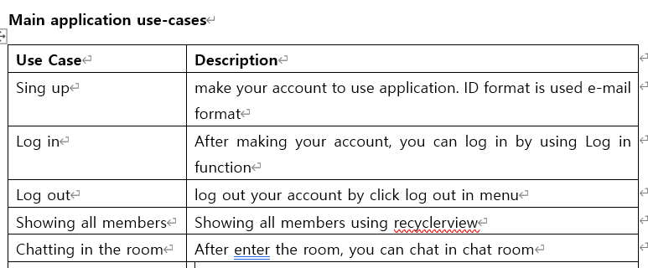
Background – function
We plan sign up, Log in, Log out and chatting functions
We develop app using firebase database.

Slide 6
Methodology

Slide 7
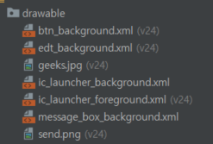
Methodology - UI/UX (drawable)
We use drawable to make UI/UX
Btn_background.xml = button background
Edt_background.xml = edit box background
Message_box_background.xml = message box background
Geeks.jpg = App present image
Send.png = send button image

Slide 8
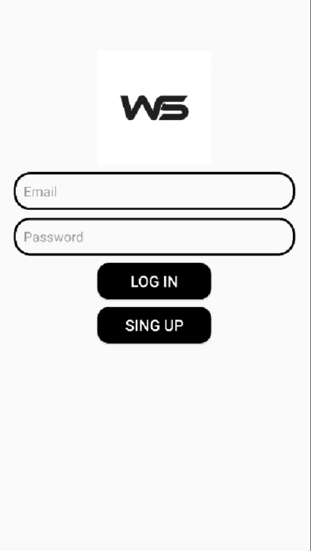
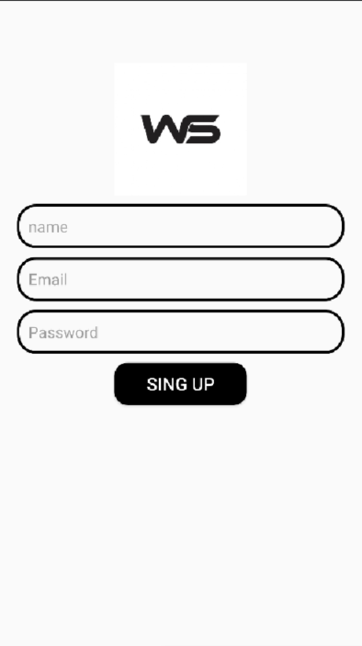
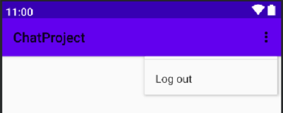
Methodology - UI/UX (layout)
Activity_log_in.xml is main intent.
You can sing up and can login
Activity_log_in.xml
Activity_sign_up.xml
menu.xml

Slide 9
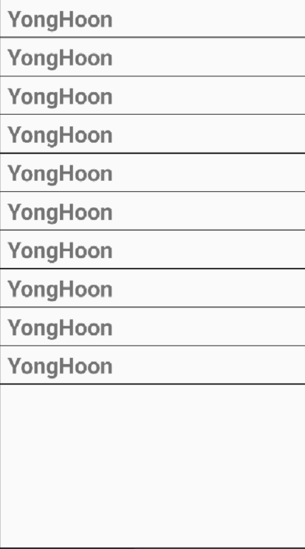
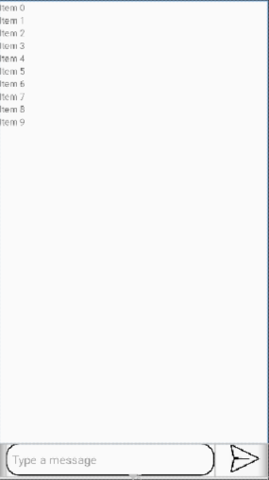
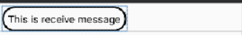

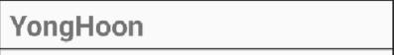
Methodology - UI/UX (layout)
receive.xml
sent.xml
User_layout.xml
User_layout.xml is item of Activity_main.xml
Receive.xml and sent.xml are items of Activity_chat.xml
Activity_main.xml
Activity_chat.xml

Slide 10
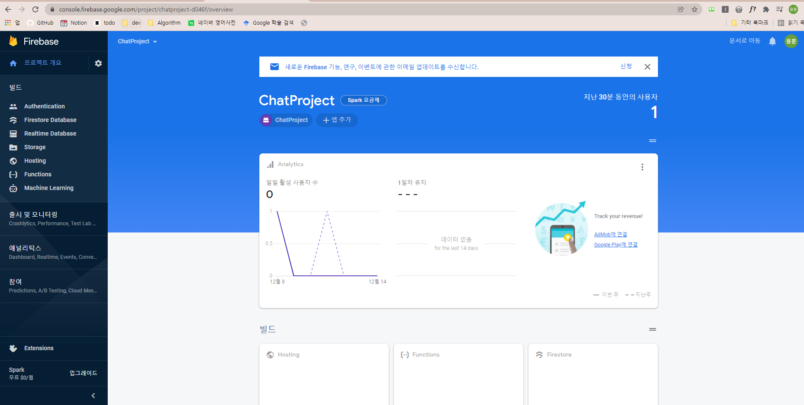

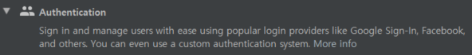
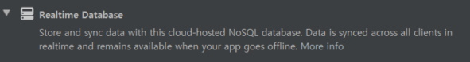
Methodology - Firebase
We use Firebase as database.
Our login and logout is using Authentication of Firebase.
Our chat function is using Realtime Database of Firebase.

Slide 11
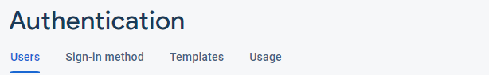
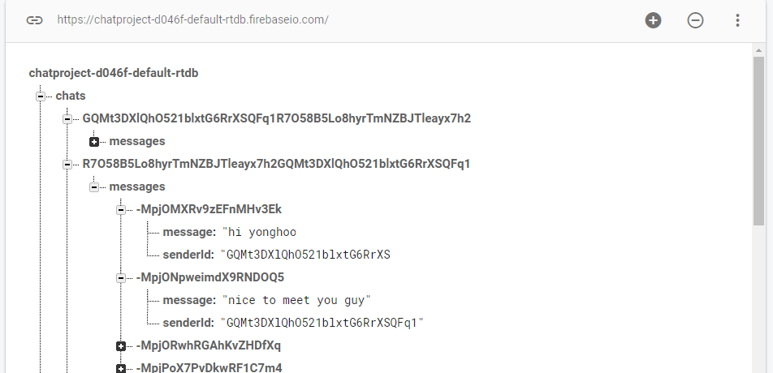
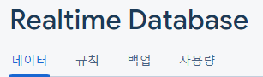
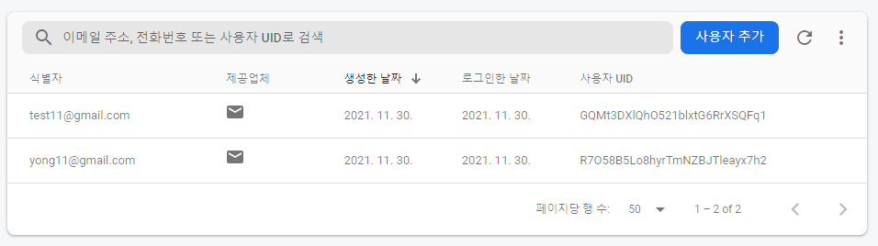
Methodology - Firebase
When user added, the user added to real time database user and authentication
When chat message is added, the user id and send message are saved in real time database
Concurrently, the user’s receive message also added to real time database

Slide 12
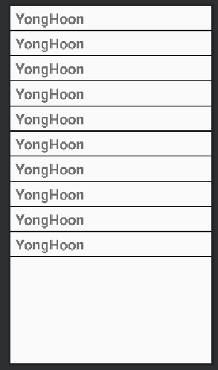
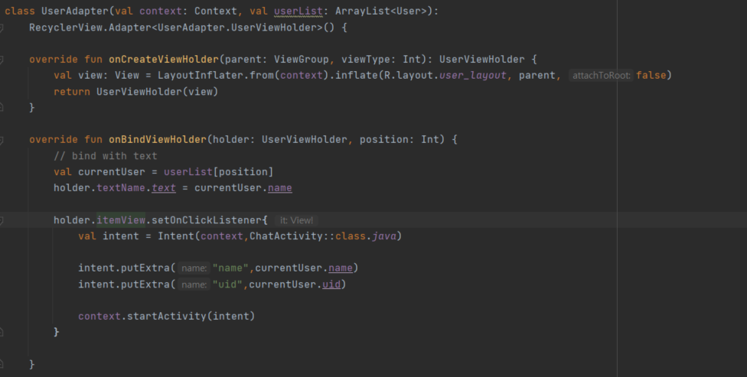
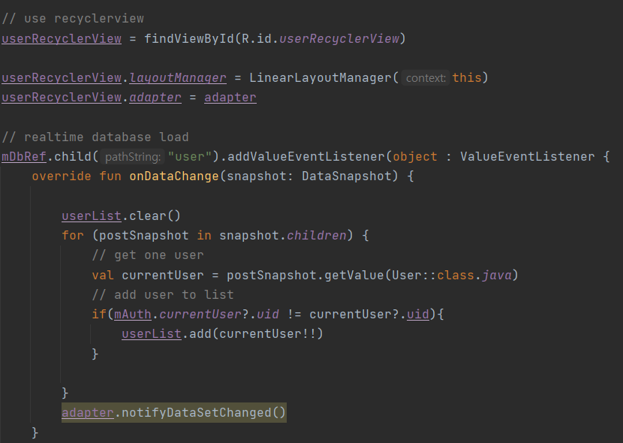
Methodology – Code (RecycleView)
UserAdapter
MainActivity
We use RecycleView to make user list

Slide 13
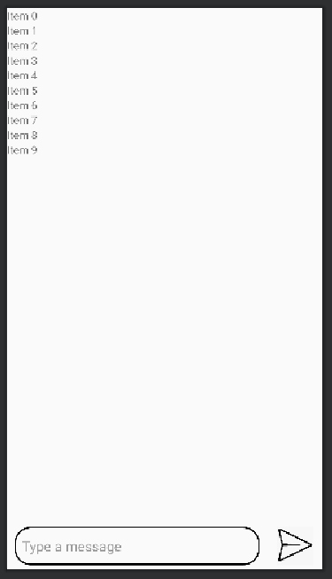
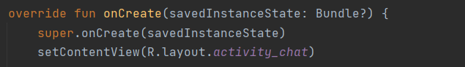
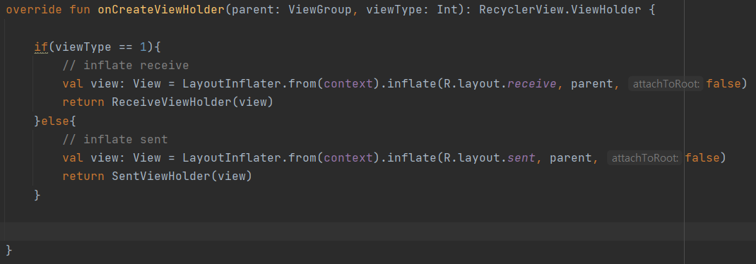
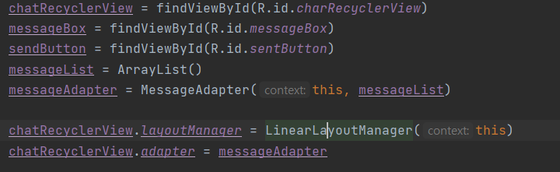
Methodology – Code (RecycleView)
MessageAdapter
ChatActivity
We use RecycleView to make chat screen

Slide 14
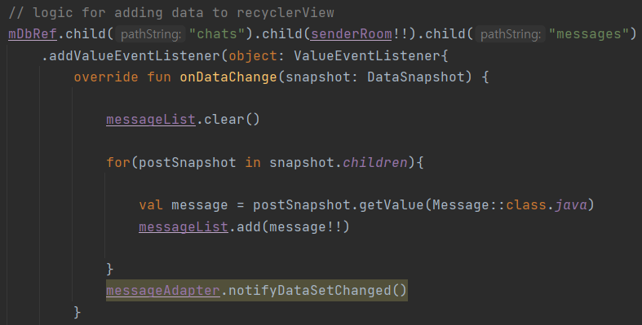
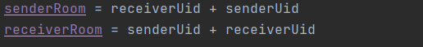
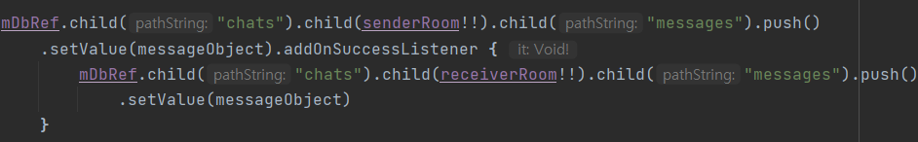
Methodology – Code (Firebase-chat)
We use mDbRef that is FirebaseDatabase
We use senderRoom and receiverRoom as a key
You can save sending chat in database by using child that having senderRoom. Also you can save receiving chat in database by using child that having receiverRoom

Slide 15


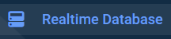
Methodology
Login signup logout
Managing chat
RecycleView
Menu
So on..

Slide 16
Demonstration

Slide 17
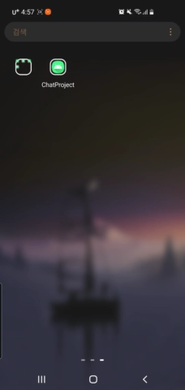
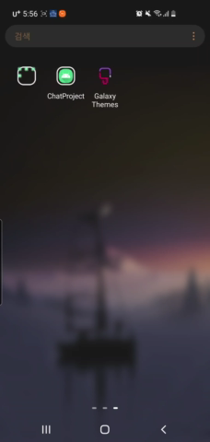
Demonstration
Sign up and Log in function
Chat function

Slide 18
Github

Slide 19
Github
Fail version as problem of Firebase
https://github.com/YHLEE9753/AndroidChatApp
Final version of project
https://github.com/YHLEE9753/Chatproject

Slide 20
Thank you for listening

